Slide 1

Crosstalk Studies for RH0026
Ricardo Escobar, Anatoly Evdokimov, Cecilia E. Gerber, Beren Ozek, Titas Roy

Slide 2
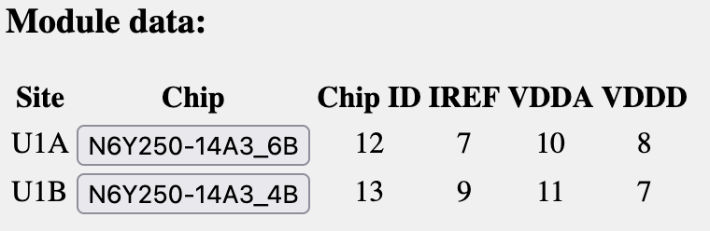
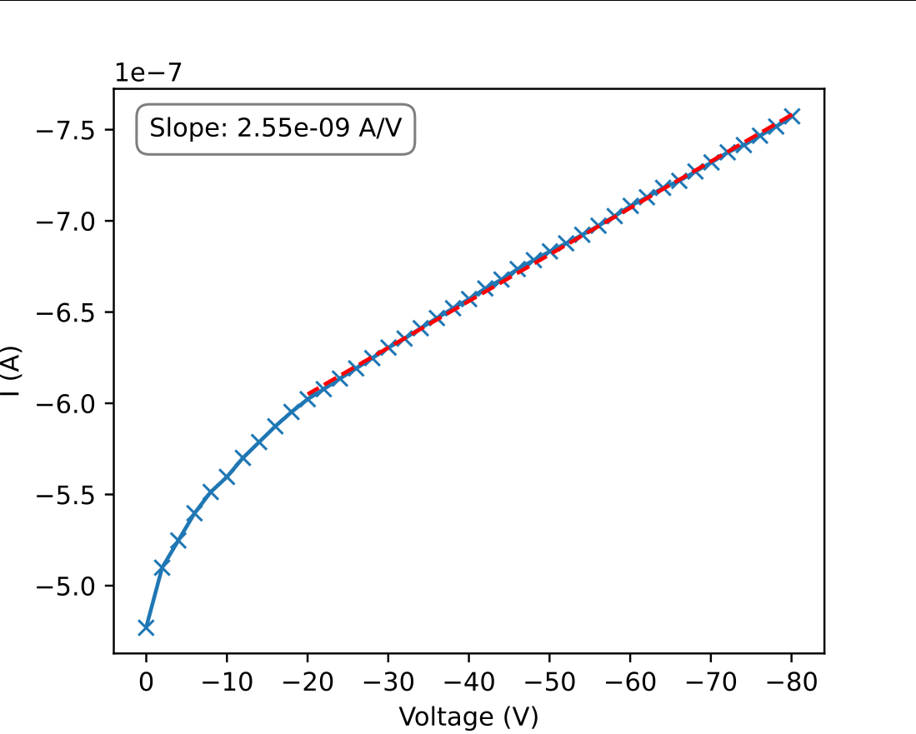
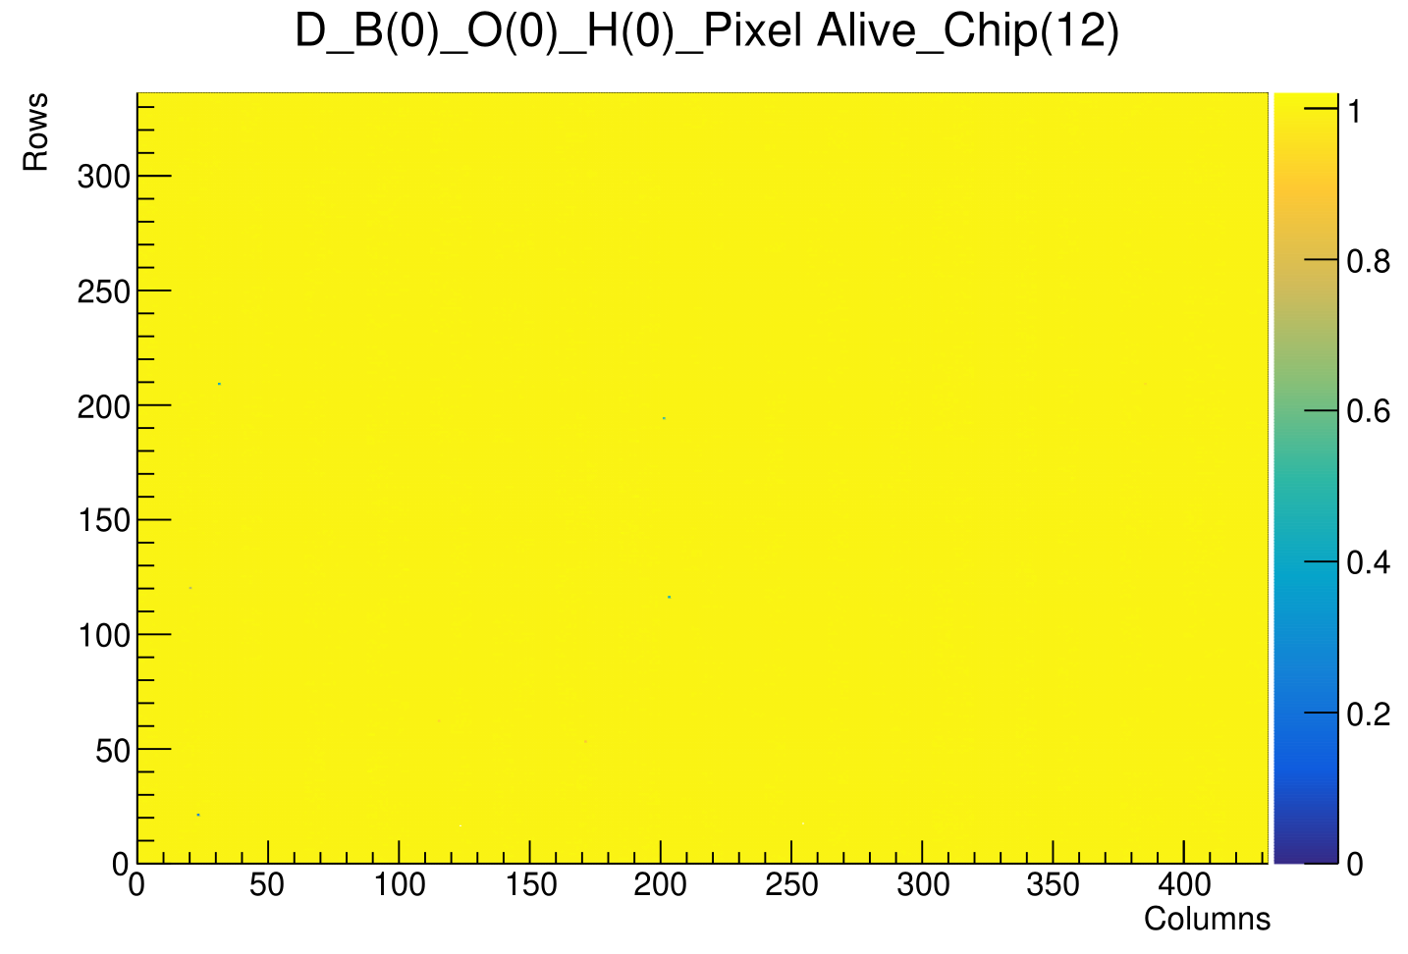
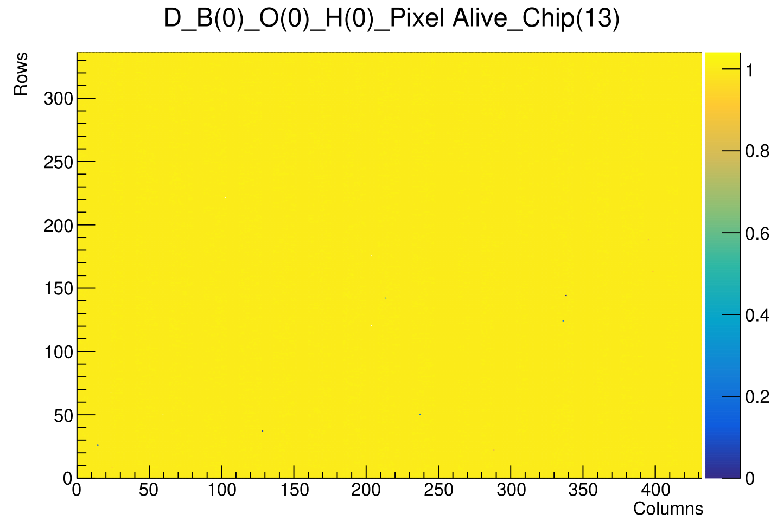
RH0026: CROCv1/HPK - Micross T-Micro - prod. @ CUA
Module data from Purdue db:
Initial QuickTest results:
1
Notes:
The complete PSI coldbox consists of an outer aluminum box that contains all other components including the plastic enclosure, inside of which the modules will be tested.
We will focus on the details of the enclosure surface.

Slide 3
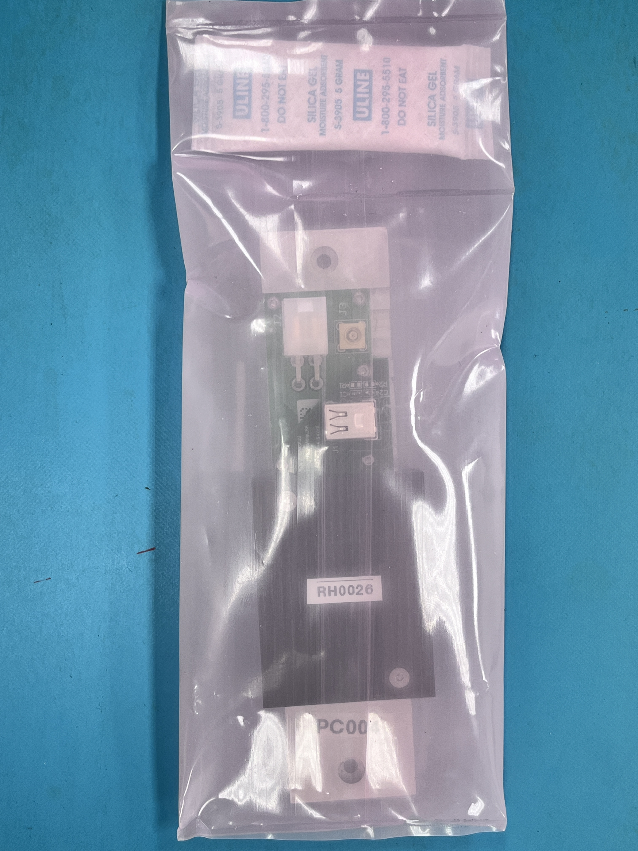
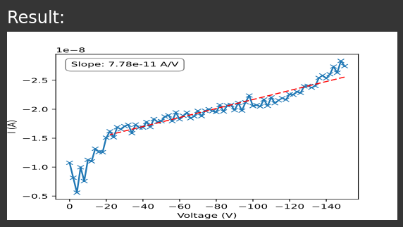
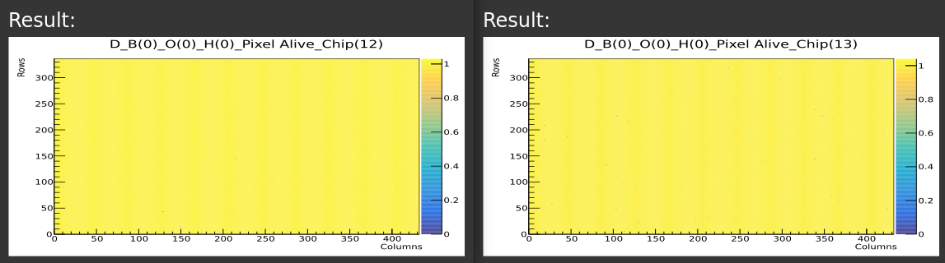
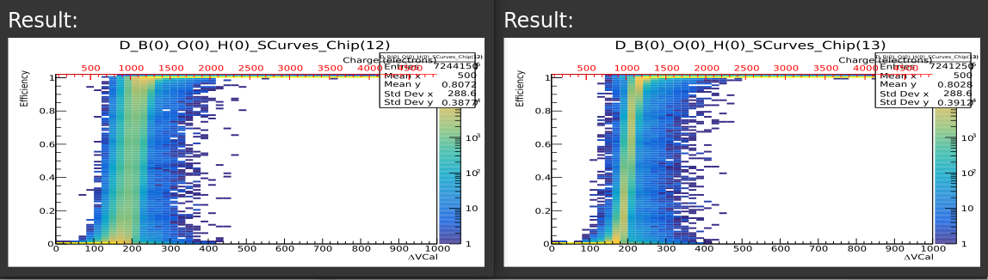
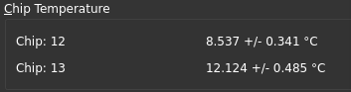
RH0026: CROCv1/HPK - Micross T-Micro - test. @ UIC
Module received sealed with desiccant.
Visual inspection showed no obvious signs of damage during transport.
QuickTest and Tuning (1k e⁻) performed at 10% RH and 0°C set temp. using UIC Coldbox and OSU GUI:
2
Notes:
The complete PSI coldbox consists of an outer aluminum box that contains all other components including the plastic enclosure, inside of which the modules will be tested.
We will focus on the details of the enclosure surface.

Slide 4
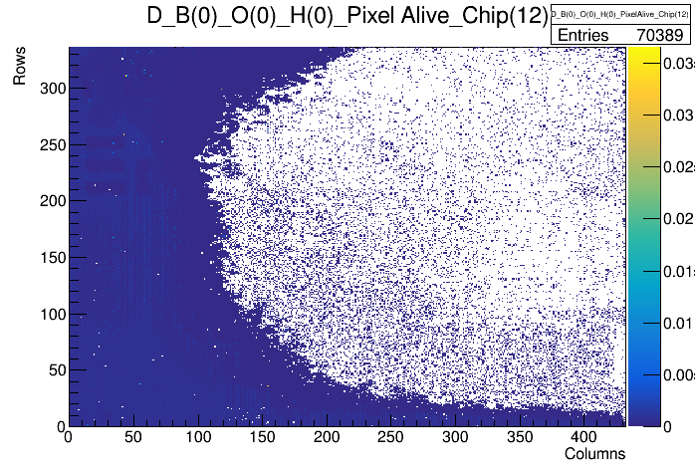
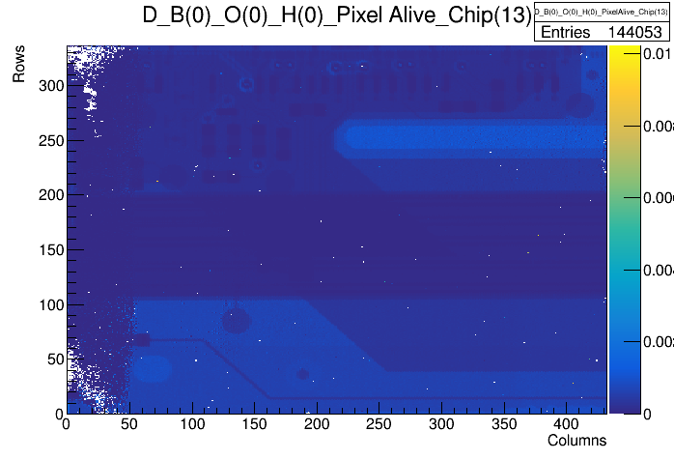
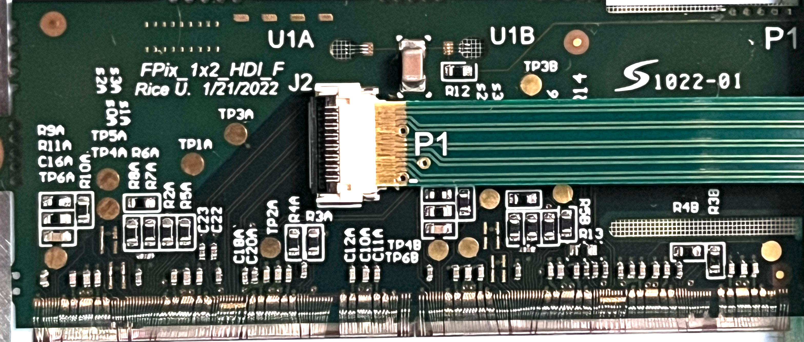
RH0026: CROCv1/HPK - Micross T-Micro – X-ray test
Module Parameters: LV = 1.80 V, 4.5 A; HV = -80 V, -0.1 μA → -1.9 μA with xray on
Xray Parameters: 40 kV, 0.8 mA
~30 min. Occupancy scan seems to have reached edges of both chips.
12
13
12
13
3
Notes:
The complete PSI coldbox consists of an outer aluminum box that contains all other components including the plastic enclosure, inside of which the modules will be tested.
We will focus on the details of the enclosure surface.

Slide 5
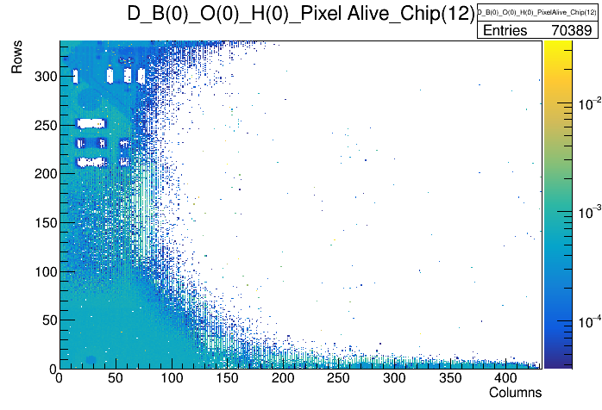
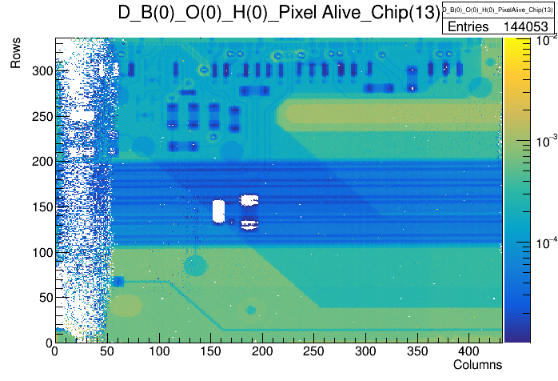
RH0026: CROCv1/HPK - Micross T-Micro – X-ray test
Module Parameters: LV = 1.80 V, 4.5 A; HV = -80 V, -0.1 μA → -1.9 μA with xray on
Xray Parameters: 40 kV, 0.8 mA
~30 min. Occupancy scan shows large empty spot near center of module.
12
13
12
13
4
Notes:
The complete PSI coldbox consists of an outer aluminum box that contains all other components including the plastic enclosure, inside of which the modules will be tested.
We will focus on the details of the enclosure surface.

Slide 6
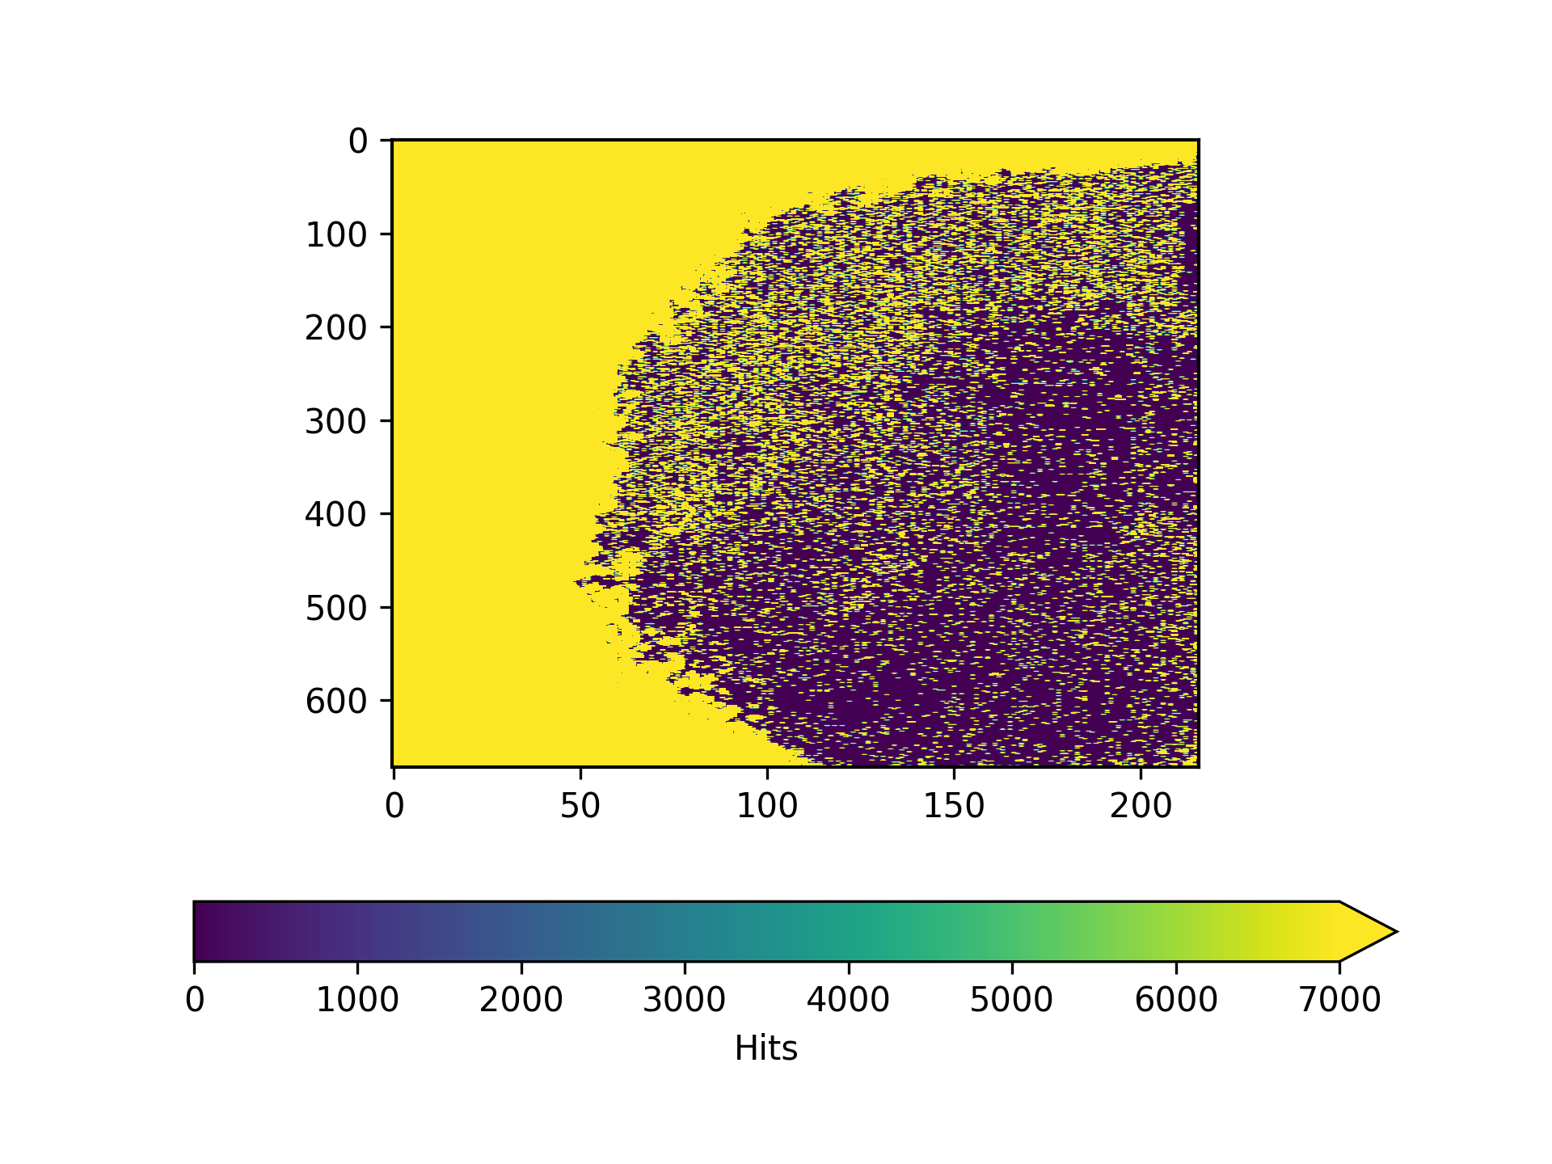
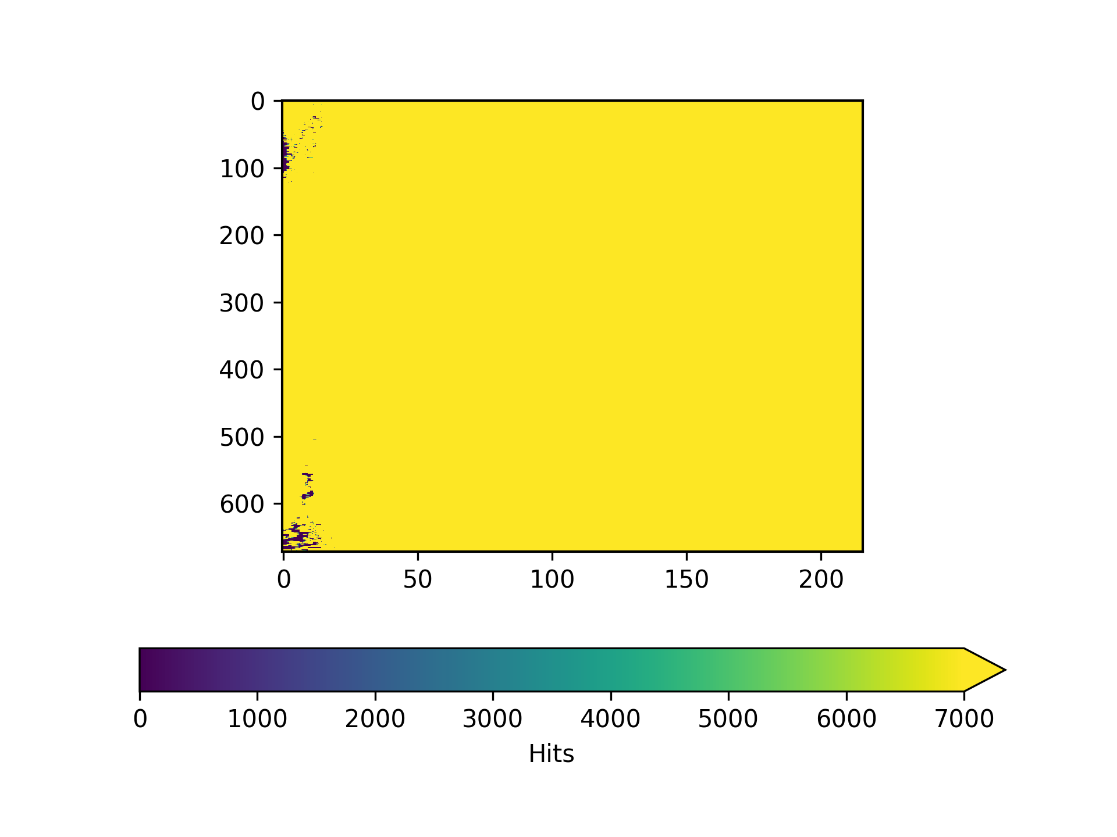
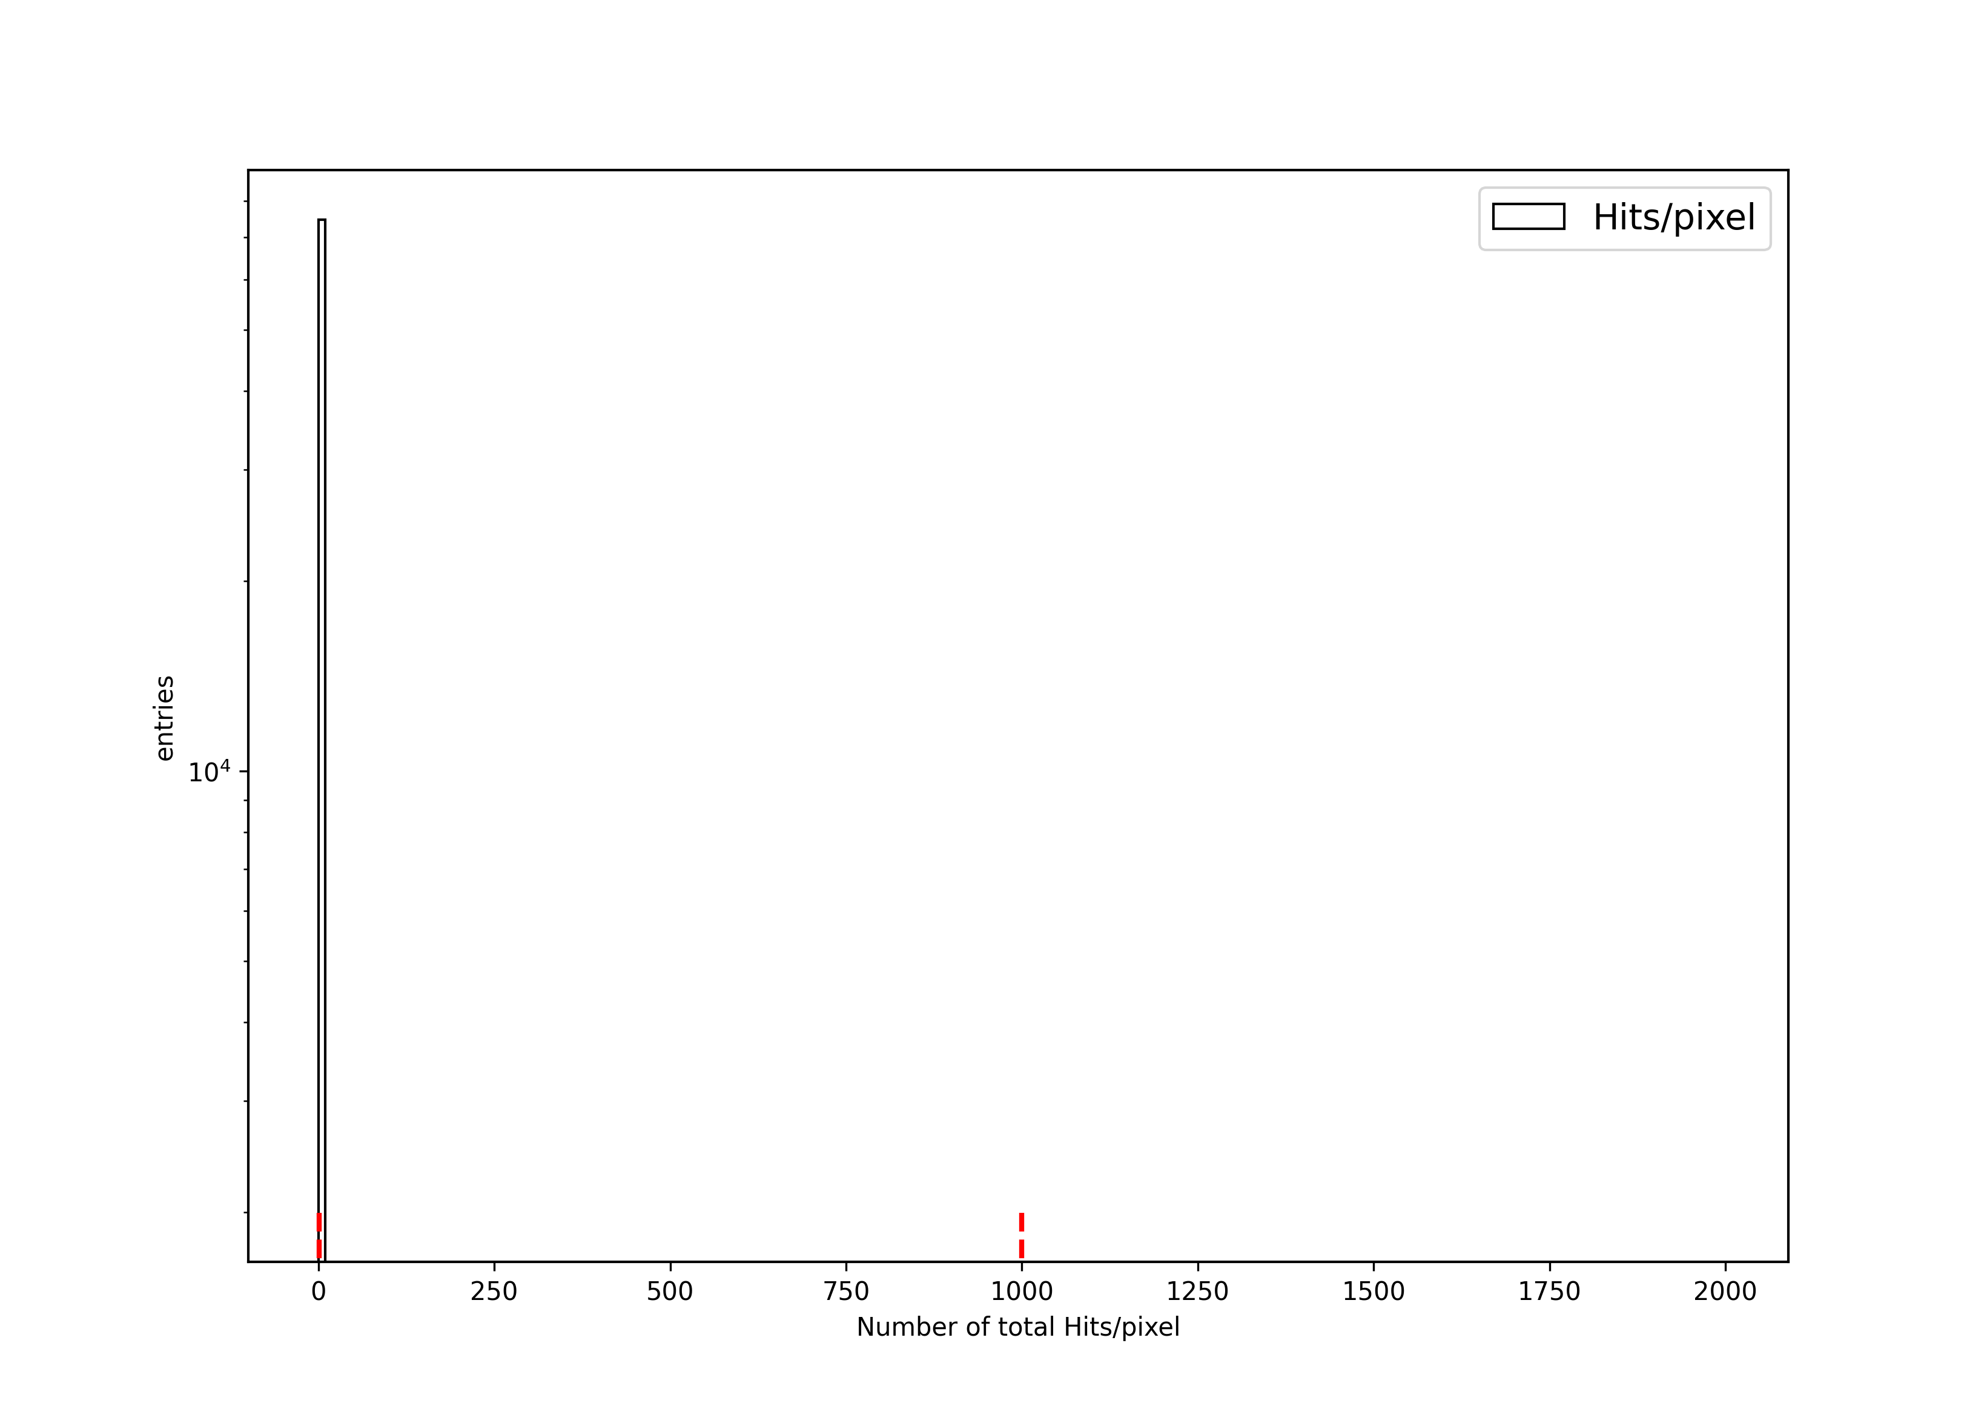
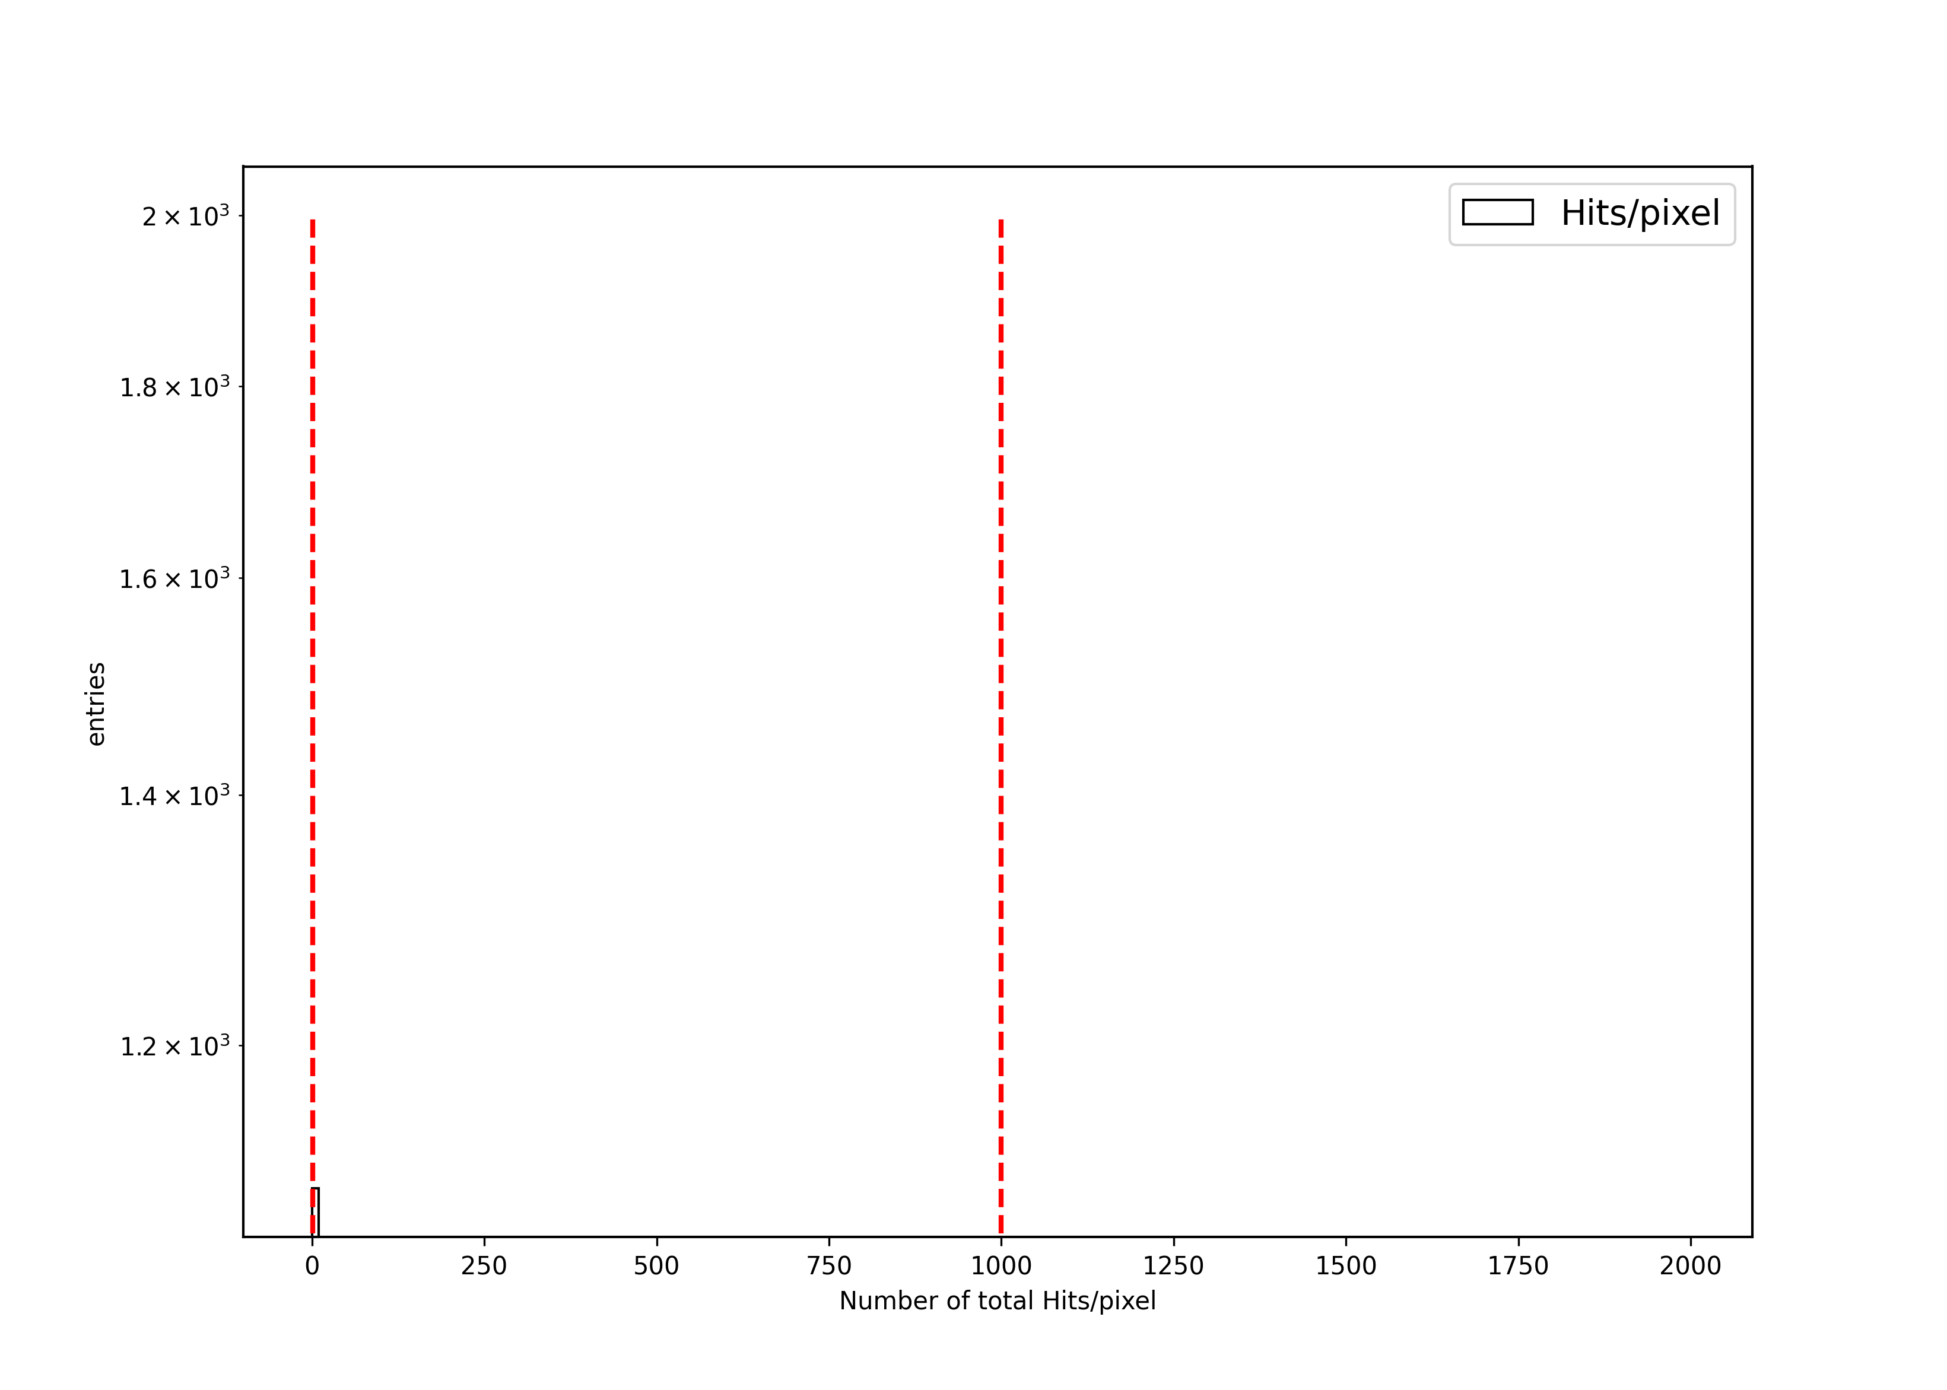
RH0026: CROCv1/HPK - Micross T-Micro – X-ray test
Definition of a Missing Bumps a pixel (not masked by Pixelalive) with no hits at all.
thank you
Massimiliano!
5
Notes:
The complete PSI coldbox consists of an outer aluminum box that contains all other components including the plastic enclosure, inside of which the modules will be tested.
We will focus on the details of the enclosure surface.

Slide 7
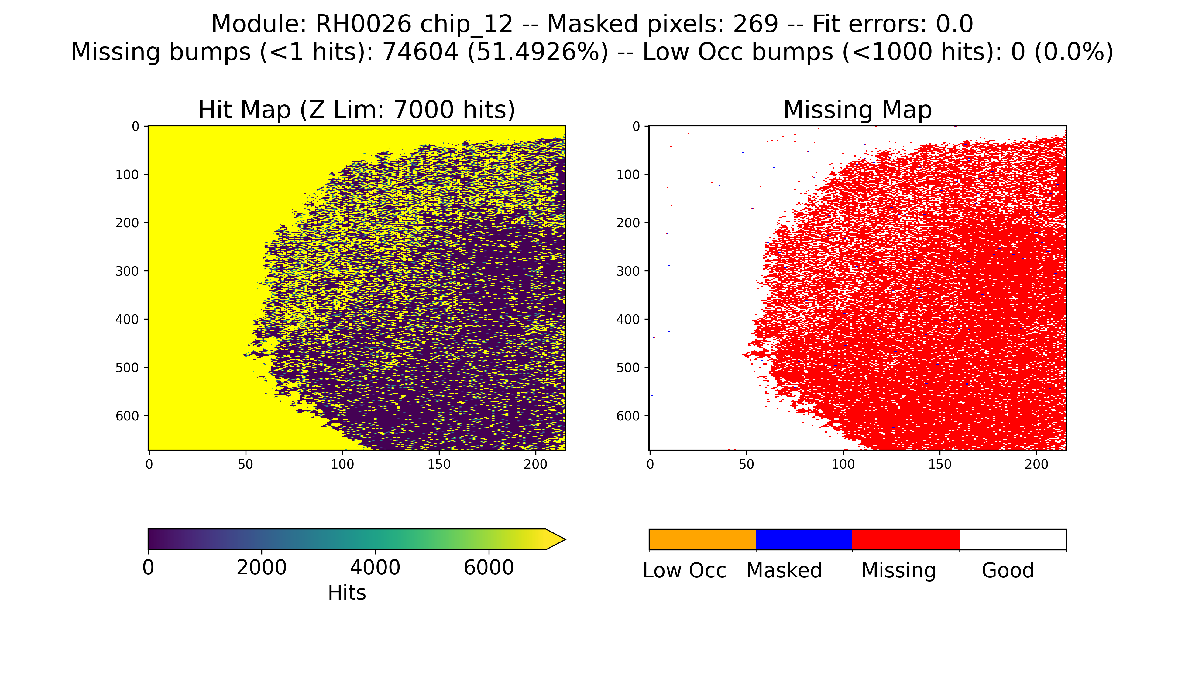
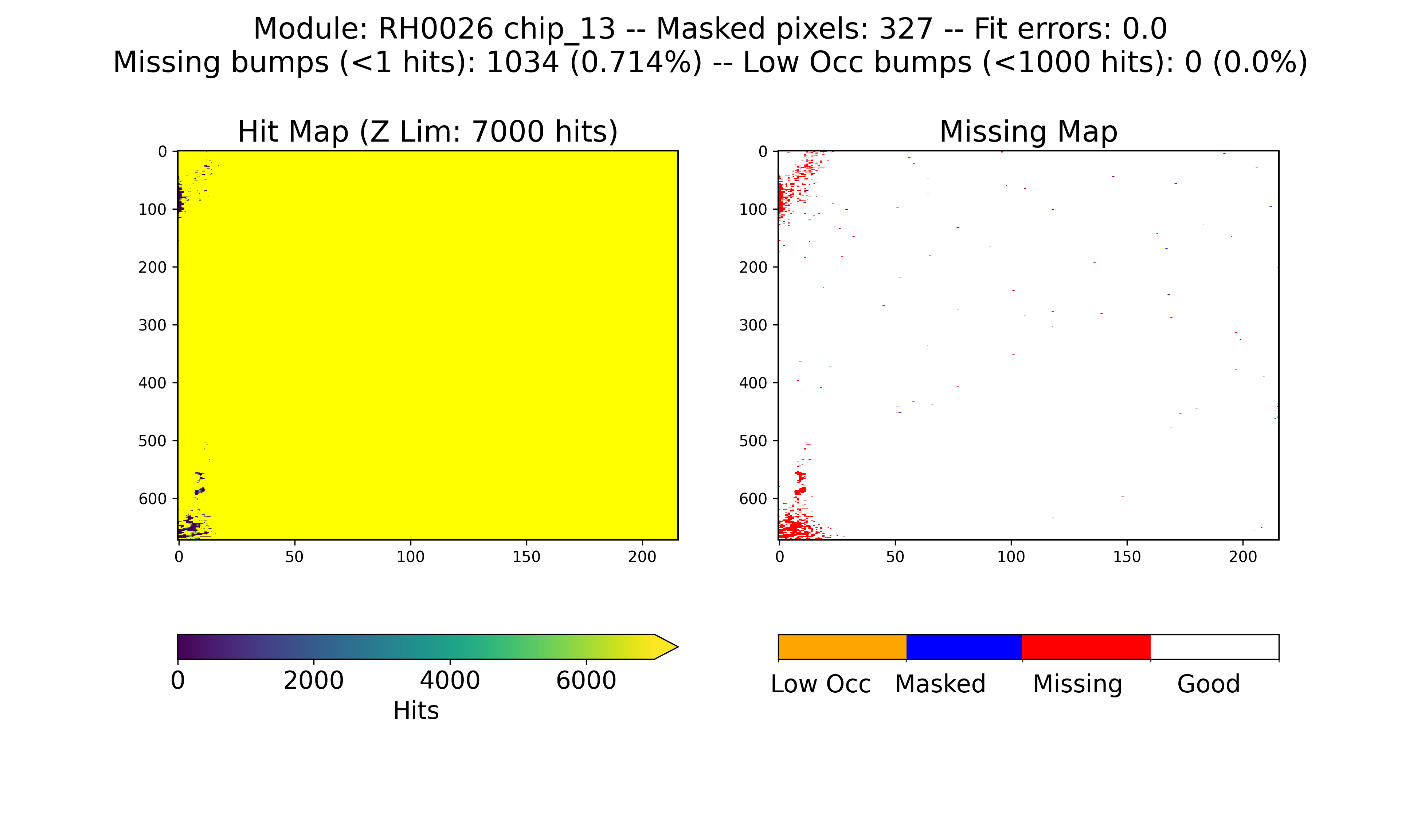
RH0026: CROCv1/HPK - Micross T-Micro – X-ray test
Definition of a Missing Bumps a pixel (not masked by Pixelalive) with no hits at all.
chip12
74604 (51.49%)
missing bumps
chip13
1034 (0.71%)
missing bumps
6
Notes:
The complete PSI coldbox consists of an outer aluminum box that contains all other components including the plastic enclosure, inside of which the modules will be tested.
We will focus on the details of the enclosure surface.

Slide 8
Thank You

Slide 9
RH0026: CROCv1/HPK - Micross T-Micro – X-ray test
8
Notes:
The complete PSI coldbox consists of an outer aluminum box that contains all other components including the plastic enclosure, inside of which the modules will be tested.
We will focus on the details of the enclosure surface.

